Slide 1

CUSTOMER RETENTION CASE STUDY
PROJECT REPORT
SUBMITTED BY:
NASHEED ASAD

Slide 2

INTRODUCTION
Customer satisfaction has emerged as one of the most important
factors that guarantee the success of the online store; it has been
posited as a key stimulant of purchase, repurchase intentions, and
customer loyalty. A comprehensive review of the literature, theories,
and models have been carried out to propose the models for customer
activation and customer retention.
Five major factors that contributed to the success of an e-commerce
store have been identified as service quality, system quality,
information quality, trust, and net benefit. The research furthermore
investigated the factors that influence online customers repeat
purchase intention. The combination of both utilitarian value and
hedonistic values is needed to affect the repeat purchase intention
(loyalty) positively. The data is collected from Indian online shoppers.
Results indicate the e-retail success factors, which are very much
critical for customer satisfaction. By increasing the utilitarian value and
hedonistic values derived by the customers, customer satisfaction and
hence the customer's repeat purchase intention can be increased
significantly.

Slide 3
OBJECTIVE
Our major goal in performing this project is to evaluate if people are purchasing items from e-commerce websites, how they gave feedback to these websites based on many positive and negative aspects, and also the details of the users based on factors such as age, gender, and so on.

Slide 4
The Hedonic value consists of factors like Gratification, Role, Best Deal, Social and Adventure
The Utilitarian value consists of factors like Product Offerings, Convenience, Product Information and Monetary Savings.
Customer Retention is based on 3 factors, according to the above diagram. They are:
Perceived Risk, Hedonic value and Utilitarian value

Slide 5

Data Analysis
There are no null values in the dataset. Also there are 70 columns of object datatype and only 1 column of int datatype.
We will divide the given dataset into 5 parts for EDA for Univariate Analysis:
1. Information about customer
2. Utilitarian value
3. Hedonic value
4. Perceived risk
5. Customer experience
Initially, we saw we had 269 rows and 71 columns but after removing the duplicates we are left with 103 rows and 71 columns.
There

Slide 6
Part 1 - Customer Information
Around 64% are women and 36% are men out of the entire participants.

Slide 7
Among the participants, most of the people belong to 21-50 years age group. We can conclude that the correspondents are mostly from working class.

Slide 8
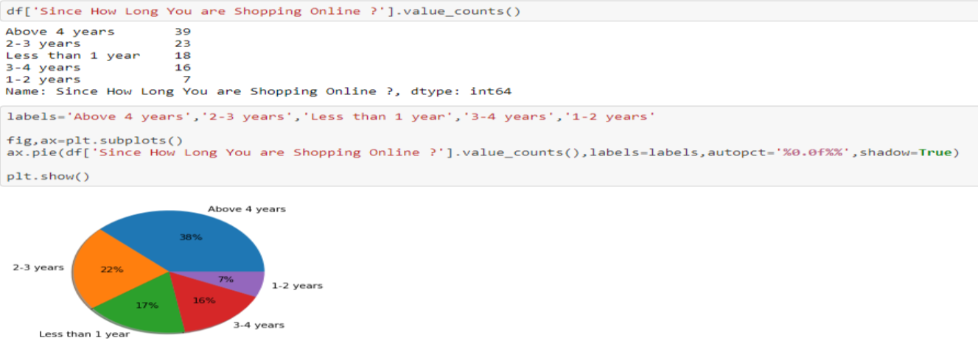
Around 54% of the participants have been shopping for more than 3 years and a considerable amount of people (around 17%) who are shopping since less than one year.

Slide 9
The respondents are majorly residing in Delhi, Greater Noida, Noida and Bangalore.

Slide 10
Majority of the people have shopped for less than 10 times in the past year.

Slide 12
Around 50% are Smartphone users and 68% use mobile internet which means E-commerce websites should be compatible with all kinds of Smartphone browsers to attract more customers.

Slide 13
Most customers use Windows OS followed by Android and Mac.

Slide 14
Google Chrome is majorly used to access the shopping website.

Slide 15
Many use search engine to find their favorite online store. Content Marketing and display ads are not that impactful. Therefore, E-commerce websites should be search engine optimized at all times and companies should spend on ads on search engines.

Slide 16
Also after repeated visits, people still use search engines instead of using an app.

Slide 17
Majority of the people spend more than 15 minutes before making a purchase.

Slide 18
The major payment method used by all is Credit/Debit cards followed by COD and E-wallets.

Slide 19
Part 2 - Utilitarian Values
The majority of participants strongly believe that the website's content must be simple to read and understand.

Slide 20
Approximately 73% of all customers believe that information on similar products to the one highlighted is useful for product comparison.

Slide 21
The majority of participants think that providing comprehensive information on the listed seller and the goods being offered is critical for making a purchase choice.

Slide 22
The majority of buyers expect all essential information about listed items to be provided properly.

Slide 25
91% of customers want a user-friendly website layout as well as ease of navigation; they also want the loading and processing speed to be as fast as possible.

Slide 27
83% of customers believe that the online retailer will complete its portion of the transaction within the time frame specified.

Slide 30
Many customers believe that purchasing online saves them money because of the cost and discount considerations.

Slide 33
Approximately 66% obtain loyalty programs from their shopping platforms.

Slide 36
Part 3 - Hedonic Values
72% of participants think that shopping from an online business is convenient.

Slide 37
More than half of online shoppers admit that they enjoy the sense of adventure that comes with internet buying.

Slide 38
Many customers do not believe that purchasing on their favorite website improves their social standing.

Slide 39
Half of all participants claim that purchasing on the website assists them in fulfilling certain responsibilities.

Slide 40
86% of customers think that they receive good value for their money when they purchase online.

Slide 41
Part 4 - Perceived Risk

Slide 42
Around 68% people abandon the shopping cart due to lack of promo code and better alternative offers.

Slide 43
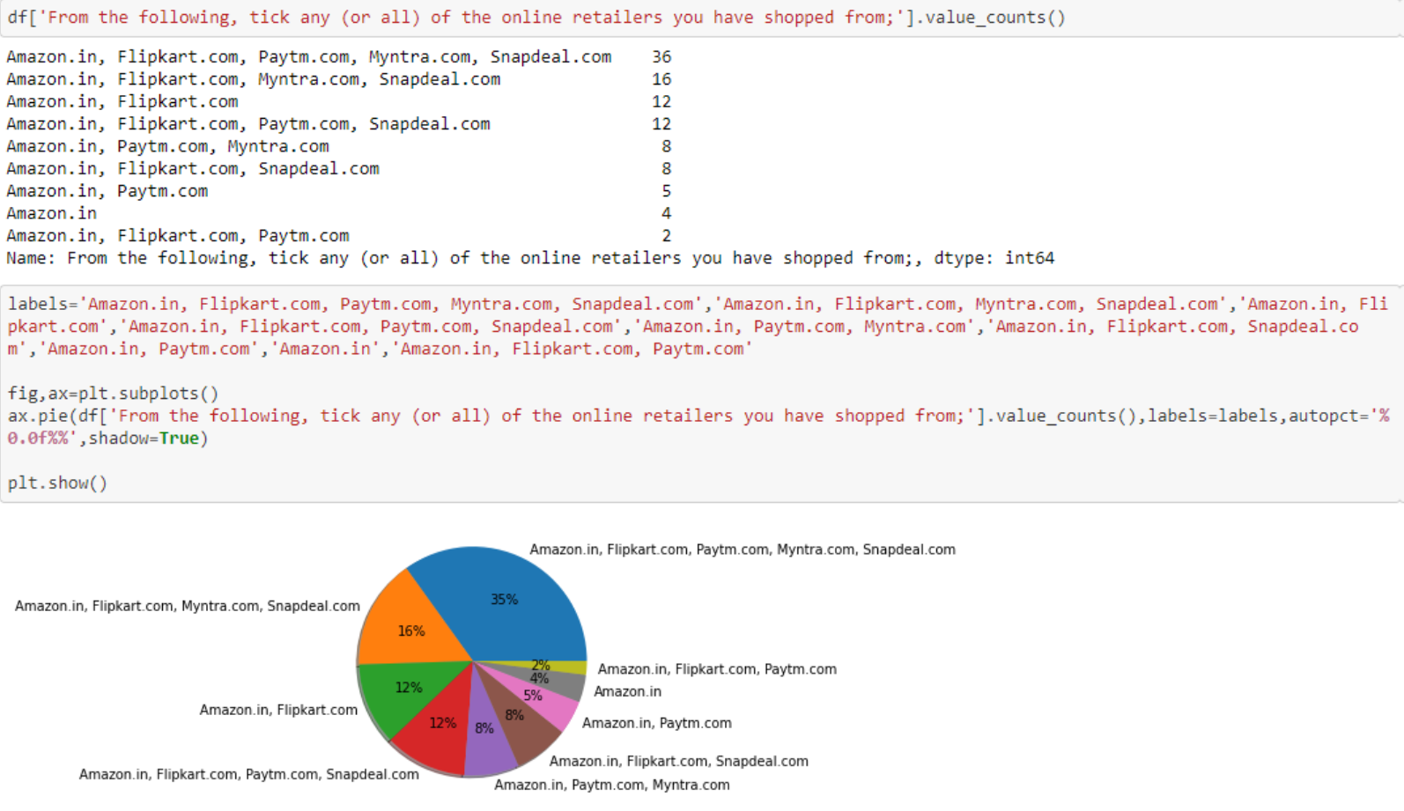
Part 5 - Customer Experience
The majority of online shoppers have mostly purchased from Amazon.in, Flipkart.com, Snapdeal.com, Paytm.com, and Myntra.com

Slide 44
Amazon, Flipkart, Snapdeal, Myntra, and Paytm appear to have user-friendly websites or applications.

Slide 45
Amazon.in and Flipkart.com have aesthetically pleasing web-page layouts.

Slide 46
Amazon.in and Flipkart.com provide a broad range of items.

Slide 47
When compared to other other websites, Amazon.in and Flipkart.com provide full and relevant product description information.

Slide 48
The websites of Amazon.in and Paytm.com load quickly.

Slide 49
Amazon.in and Flipkart.com have a high level of consumer trust.

Slide 50
Amazon.in, Flipkart.com, and Paytm.com are all quick to complete purchases.

Slide 51
Amazon.in and Flipkart.com accept a variety of payment methods.

Slide 52
Orders are delivered quickly on Amazon.in and Flipkart.com.

Slide 53
According to consumers, Amazon.in and Flipkart.com protect the privacy of customers information.

Slide 54
According to consumers, Amazon.in and Flipkart.com protect security of their financial information.

Slide 55
Amazon.in has the highest level of perceived trustworthiness.

Slide 56
Amazon.in, Flipkart.com, Myntra, and Snapdeal.com are the most prominent providers of multi-channel online help.

Slide 57
Amazon.in, Flipkart.com, and Paytm.com take longer to log in.

Slide 58
It takes longer time for Amazon.in and Flipkart.com to show graphics and pictures.

Slide 59
Late price declaration is a practice at Myntra.com, Paytm.com, Flipkart, and Snapdeal.com.

Slide 60
Myntra.com and Paytm has a longer page loading time (promotion, sales period).

Slide 61
Most items on Amazon.in and Snapdeal.com have a limited mode of payment.

Slide 62
Paytm.com, snapdeal.com, Flipkart.com has a longer delivery period.

Slide 63
The website/application design of Amazon.in and Paytm.com changes on a regular basis.

Slide 64
There is frequent interruption while switching from one page to another on Amazon.in, Myntra.in, Snapdeal.com, and Paytm.com.

Slide 65
The Amazon.in and Flipkart.com websites are still as efficient as before.

Slide 66
The top recommended Indian internet store websites appear to be Amazon.in and Flipkart.com.

Slide 67
Conclusion
The purpose of this study is to understand the influence of utilitarian values, hedonic values, customer experience and perceived risk on E-commerce customer satisfaction in India.
The analysis shows that the Utilitarian Value significantly influences Customer Satisfaction, meaning that the level of Utilitarian Value of e-commerce customers will affect the level of Customer Satisfaction. In other words, the better (higher) Utilitarian Value given by e-commerce products will lead to satisfaction with customers. Hedonic Value significantly influences Customer Satisfaction, meaning that the high and low Hedonic Value of e-commerce customers will affect the level of Customer Satisfaction. In other words, the higher the Hedonic Value given by e-commerce products will lead to the satisfaction of e-commerce customers.
Based on all the factors mentioned above, we see Amazon and Flipkart are doing great in their performance on customer satisfaction and retention.

Slide 68




THANK YOU!
Nasheed Asad
nasheed5feb@gmail.com
9903780787

